Slide 1
SOFTWARE CONFIGURATION MANAGEMENT
COMP6100001 - Software engineering
Session 15
Kenny Jingga, S.Kom., M.T.

Slide 2
Session 15 – SOFTWARE CONFIGURATION MANAGEMENT
Learning objectives
At the end of this session, students will be expected to be able to:
Understand the configuration concept for software development
Understand how to configurate software

Slide 3
Session 15 – SOFTWARE CONFIGURATION MANAGEMENT
Content outline
Introduction to Software Configuration Management
Key Concepts in SCM
SCM Processes and Activities
SCM Planning and Implementation
SCM Tools and Techniques
SCM in Agile and DevOps Environments

Slide 4
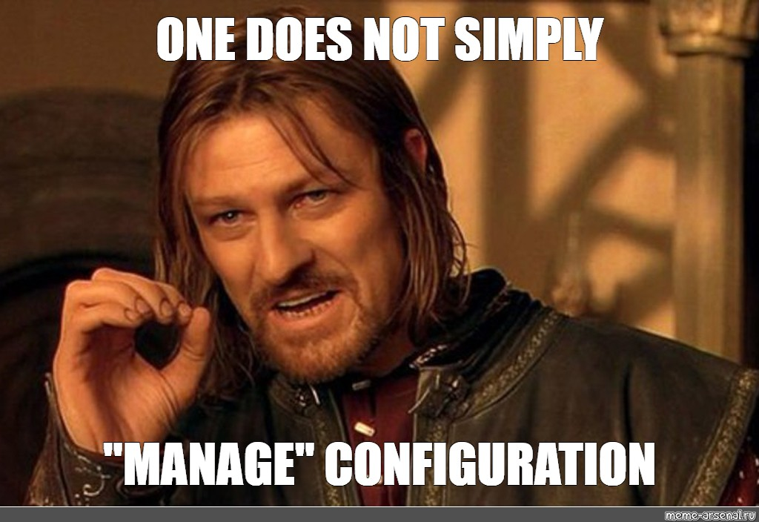
Introduction to Software Configuration Management

Slide 5
Introduction to Software Configuration Management
Definition and importance of SCM
Software Configuration Management (SCM) is a discipline within software engineering that focuses on controlling and tracking changes in software, ensuring integrity and traceability throughout the software development life cycle.
Importance:
  Control of Change: Manages and documents changes to prevent errors and inconsistencies.
  Team Collaboration: Facilitates coordination among team members, especially in large projects.
  Quality Assurance: Ensures that the software maintains its integrity over time.
  Compliance and Traceability: Provides an audit trail for changes, important for regulatory compliance.

Slide 6
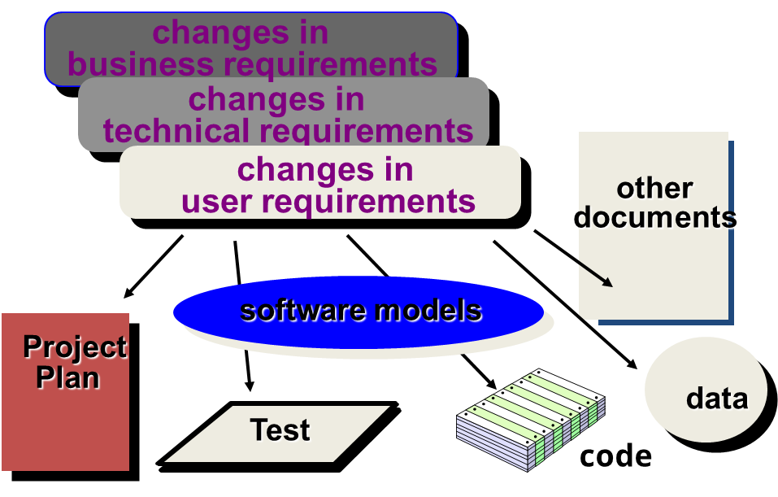
Introduction to Software Configuration Management
What Are These Changes?

Slide 7
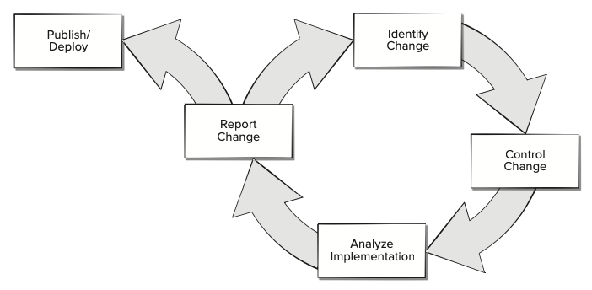
Introduction to Software Configuration Management
Software Configuration Management Work Flow
Software configuration management (SCM) is an umbrella activity that is applied throughout the software process
Change can occur at any time, so SCM activities are developed to (1) identify change, (2) control change, (3) ensure that change is being properly implemented, and (4) report changes to others who may have an interest.

Slide 8
Key Concepts in SCM
Software Configuration items (SCI)
SCI are the artifacts that are placed under configuration management. This includes code files, documents, requirements, test cases, and more.
Examples:
  Source code files
  Design documents
  User manuals
  Test scripts
  Build scripts
  Requirements specifications

Slide 9
Key Concepts in SCM
BaseLines
A baseline is a formally reviewed and agreed-upon version of a configuration item, which serves as a starting point for further development and can be changed only through formal change control procedures.
Types of Baselines:
  Functional Baseline: Initial specifications established during requirements analysis.
  Design Baseline: Established after the design phase.
  Product Baseline: The final product, including all components and documentation.

Slide 10
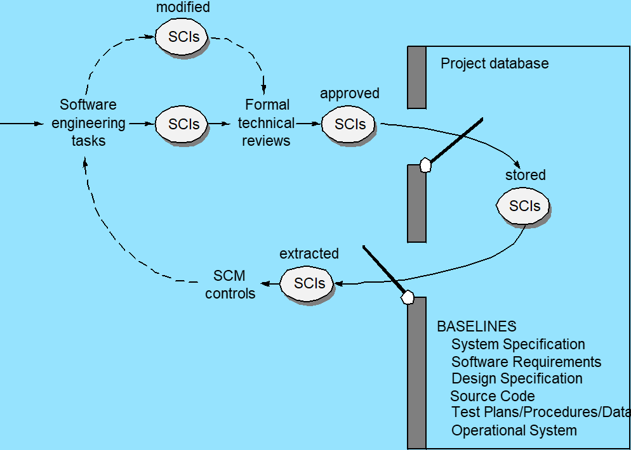
Key Concepts in SCM
Baselines

Slide 11
Key Concepts in SCM
Versions
Different states of a configuration item as it evolves over time.
Versioning Practices:
  Semantic Versioning: Major.Minor.Patch (e.g., 1.2.3)
    Major: Incompatible API changes.
    Minor: Backwards-compatible functionality.
    Patch: Backwards-compatible bug fixes.

Slide 12
Key Concepts in SCM
Change Control And Management
Change Control Process:
Change Request Submission: Initiated by stakeholders when a change is needed.
Evaluation: Assess impact, feasibility, and necessity of the change.
Approval/Rejection: Decision made by a Change Control Board (CCB).
Implementation: Approved changes are implemented according to plan.
Verification: Changes are tested and validated to ensure they meet requirements.
Release: Updated configuration items are formally released.
Change Control Board (CCB):
  A group of stakeholders responsible for evaluating and approving changes to the software configuration.

Slide 13
SCM Processes and Activities
Configuration identification
Purpose:
  Determine which items need to be controlled and tracked throughout the project.
Activities:
  Identifying Configuration Items: Establishing a list of items that are to be placed under configuration control.
  Assigning Identifiers: Assigning unique identifiers (names, numbers) to each configuration item for tracking purposes.
  Creating Configuration Structures: Defining relationships among configuration items.

Slide 14
SCM Processes and Activities
Configuration Control
Purpose:
  Manage changes systematically to maintain software integrity and traceability.
Activities:
  Change Management: Processing and tracking change requests through a defined process.
  Change Evaluation: Assessing the impact of proposed changes on cost, schedule, and quality.
  Change Implementation: Planning and executing approved changes.
  Version Control: Managing multiple versions and variants of configuration items.

Slide 15
SCM Processes and Activities
Configuration Status Accounting
Purpose:
  Record and report information needed to manage configuration items effectively.
Activities:
  Status Reporting: Providing information on the current status of configuration items, including version numbers, change history, and implementation status.
  Tracking Metrics: Collecting data on the number of changes, types of changes, and time to implement changes.

Slide 16
SCM Processes and Activities
Configuration Audits and Reviews
Purpose:
  Ensure that the software configuration items conform to their specifications and that the correct versions are being used.
Types of Audits:
  Functional Configuration Audit (FCA): Verifies that the functional requirements are met.
  Physical Configuration Audit (PCA): Confirms that the product has been built according to the specified design and documentation.
Activities:
  Audit Planning: Defining the scope and objectives of the audit.
  Conducting Audits: Reviewing documentation, code, and processes.
  Reporting: Documenting findings and recommendations.

Slide 17
SCM Processes and Activities
Change Control Board (CCB) Roles and Responsibilities
Roles:
  CCB Chairperson: Leads the board and facilitates decision-making.
  Members: Representatives from development, QA, project management, and other stakeholders.
Responsibilities:
  Review Change Requests: Evaluate the necessity and impact of changes.
  Decision Making: Approve, reject, or defer change requests.
  Prioritization: Determine the urgency and importance of changes.
  Communication: Inform stakeholders about decisions and changes.

Slide 18
SCM Planning And Implementation
Developing an SCM Plan
Purpose:
  Outline how SCM processes will be applied in the project.
Components of an SCM Plan:
  Introduction: Objectives and scope.
  Organization: Roles and responsibilities.
  Configuration Identification: Criteria for selecting configuration items.
  Configuration Control: Procedures for managing changes.
  Status Accounting: Methods for tracking and reporting.
  Audits and Reviews: Schedules and processes.
  Tools and Resources: Software and hardware to be used.
  Training Requirements: SCM training for team members.

Slide 19
SCM Planning And Implementation
Roles and Responsibilities in SCM
SCM Manager:
  Oversees SCM activities, develops SCM plans, and ensures compliance.
Configuration Librarian:
  Manages the storage and retrieval of configuration items.
Developers and Engineers:
  Follow SCM procedures, maintain accurate records, and participate in change control.
Quality Assurance Personnel:
  Ensure that SCM processes are adhered to and that products meet quality standards.

Slide 20
SCM Planning And Implementation
Integrating SCM into Software Development Life Cycle (SDLC)
Integration Points:
  Requirements Phase: Identify initial configuration items.
  Design Phase: Establish baselines for design documents.
  Implementation Phase: Apply version control to code and documents.
  Testing Phase: Manage test cases and results as configuration items.
  Deployment Phase: Control releases and updates.
  Maintenance Phase: Manage changes and updates over time.
Benefits:
  Ensures consistency and control throughout the SDLC.
  Facilitates communication and coordination among teams.

Slide 21
SCM Tools and Techniques
Build Management Tools
Purpose:
  Automate the process of compiling source code into executable programs.
Common Tools:
  Make: Uses Makefiles to define build processes.
  Ant/Maven (Java): Build and project management tools for Java applications.
  Gradle: Flexible build automation system.
Benefits:
  Consistent builds across environments.
  Automation reduces human error.
  Supports continuous integration practices.

Slide 22
SCM Tools and Techniques
Release Management
Definition:
  The process of managing, planning, scheduling, and controlling a software build through different stages and environments.
Activities:
  Release Planning: Define scope and schedule of releases.
  Release Preparation: Assemble release components and documentation.
  Deployment: Install the software in the target environment.
  Post-Release Review: Evaluate release performance and issues.
Best Practices:
  Maintain a release calendar.
  Use automation tools for deployment.
  Ensure rollback procedures are in place.

Slide 23
SCM Tools and Techniques
Issue and Defect Tracking Systems
Purpose:
  Track and manage reported issues, bugs, and enhancement requests.
Common Tools:
  Jira: Comprehensive issue tracking and project management.
  Bugzilla: Open-source bug tracking system.
  Redmine: Flexible project management web application.
Benefits:
  Centralized tracking of issues.
  Assignments and notifications.
  Reporting and analytics.

Slide 24
SCM Tools and Techniques
Documentation management
Importance:
  Ensures that all project documentation is current, accessible, and under configuration control.
Activities:
  Versioning Documents: Manage revisions and updates.
  Access Control: Define who can view or edit documents.
  Collaboration Tools: Enable team members to work together efficiently.
Tools:
  Confluence: Collaboration and documentation platform.
  SharePoint: Web-based collaborative platform.
  Google Docs: Cloud-based document management.

Slide 25
SCM in Agile and DevOps Environments
Continuous Integration and Continuous Deployment (CI/CD)
Continuous Integration (CI):
  Developers frequently integrate code into a shared repository.
  Automated builds and tests detect errors early.
Continuous Deployment (CD):
  Automated deployment of code changes to production after passing tests.
SCM Role in CI/CD:
  Manages code changes and tracks versions.
  Facilitates automated build and deployment pipelines.
  Ensures that only approved changes are deployed.

Slide 26
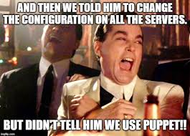
SCM in Agile and DevOps Environments
Infrastructure as Code (IaC)
Definition:
  Managing and provisioning infrastructure through code rather than manual processes.
Benefits:
  Consistency and repeatability.
  Version control of infrastructure configurations.
  Easier to manage complex environments.
Tools:
  Terraform: Infrastructure provisioning tool.
  Ansible: Automation platform for configuration management.
  Chef/Puppet: Configuration management tools.

Slide 27
SCM in Agile and DevOps Environments
SCM Best Practices in Modern Development
Automation:
  Automate repetitive tasks to increase efficiency and reduce errors.
Integration with CI/CD:
  Ensure SCM processes and tools integrate seamlessly with CI/CD pipelines.
Code Reviews:
  Implement peer reviews for all code changes to maintain quality.
Testing:
  Incorporate automated testing at every stage of development.
Documentation:
  Maintain clear and up-to-date documentation of SCM processes and configurations.

Slide 28
EXERCISES
Assume that you're the manager of a small project. What baselines would you define for the project and how would you control them?
Briefly describe the differences between SCM for conventional software and SCM for WebApps

Slide 29
References
Pressman & Maxim (2020). Software Engineering: A Practitioner's Approach. [Chapter 29]
Winters et al. (2020). Software Engineering at Google. [Chapters 22-24]

